Slide 1

Electricity Consumption Analysis
Group Members:
Aakash Singh
Jin-Hyuk Son
Julio Montoya
Sagar Shah

Slide 2
Agenda
01 | OVERVIEW OF DATA
02 | SMART QUESTIONS
03 | MODELING

Slide 3
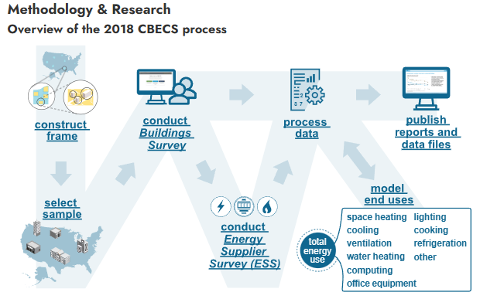
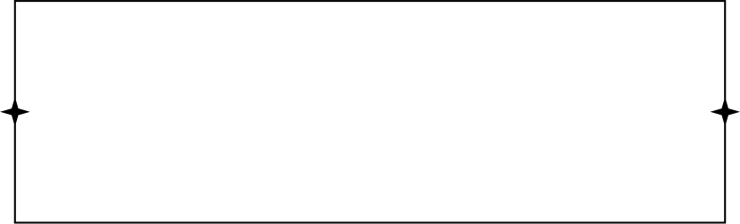
Data Source
Commercial Buildings Energy Consumption Survey (CBECS)
Source: US Energy Information Administration (EIA)
Roughly 6400 observations with 620 questionnaire variables

Slide 4
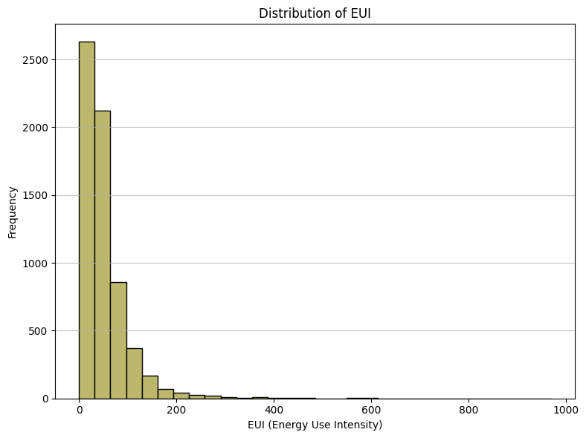
Energy Use Intensity (EUI)
Energy Use Intensity (EUI) - measure of a building's energy consumption relative to its size. (kBtu/ft²/year)
Adjusts for building size, enabling fair comparisons across small and large buildings.
Allows to identify energy usage patterns based on building characteristics to promote sustainable and efficient energy practices.

Slide 5
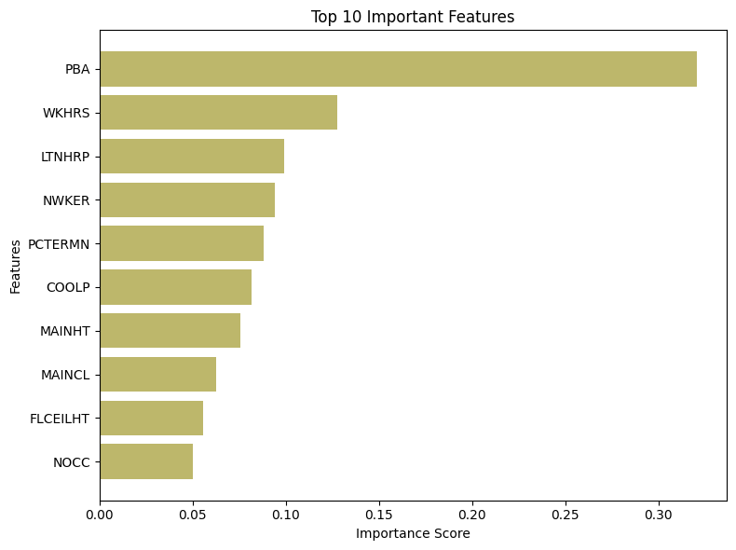
Selected Variables
Utilized SelectKBest method to rank features by their relevance to the target variable (EUI).
Chose Mutual Information Regression as the scoring function for its ability to capture nonlinear relationships.
Evaluated multicollinearity among the selected features using the Variance Inflation Factor (VIF)
PBAPLUS - Specific Building Activity
WKHRS - Total hours open per week
LTNHRP - Percent lit during off hours
NWKER - Number of employees during the main shift
PCTERMN - Number of desktop computers
COOLP - Percent of building cooled
MAINHT - Main Heating Equipment
MAINCL - Main Cooling Equipment
FLCEILHT - Floor to ceiling height
NOCC - Number of businesses in the building

Slide 6
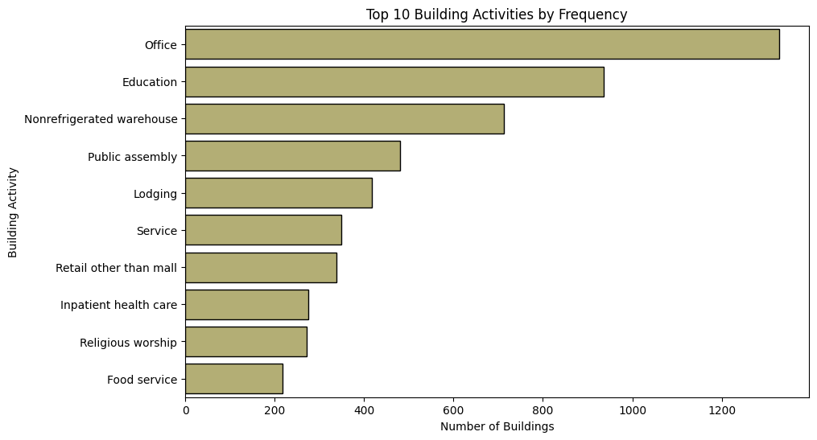
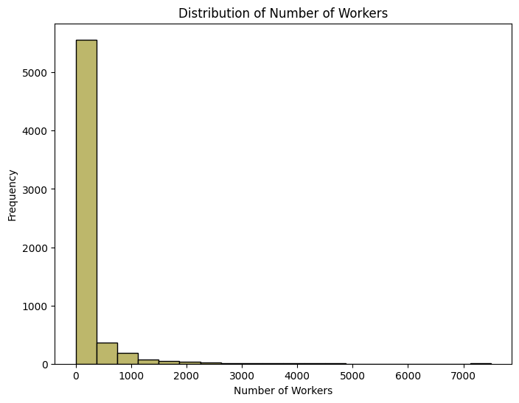
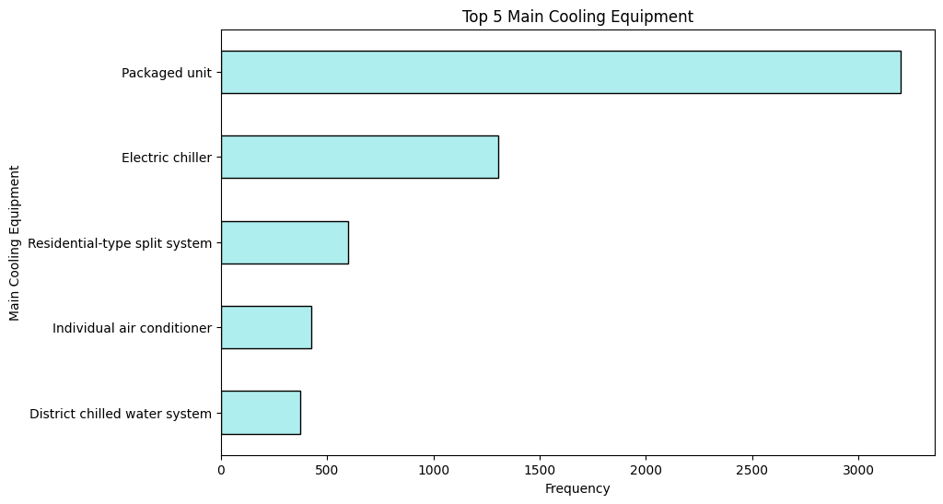
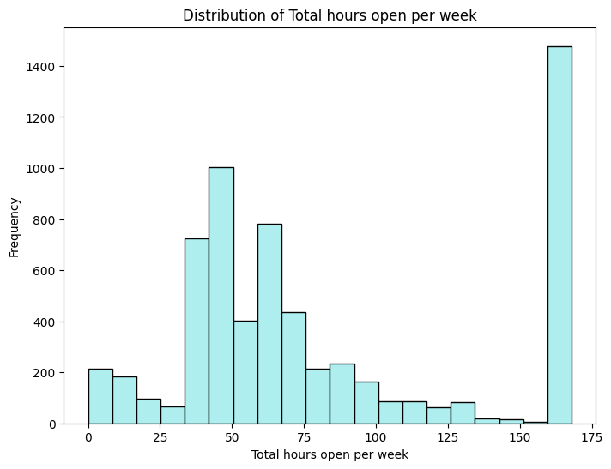
Overview of Data

Slide 7


SMART Questions
How can buildings be clustered into groups based on their 2018 annual electricity consumption, and what characteristics are observed in each resulting cluster?
How do the percentage of a building area that is cooled and the type of main cooling equipment influence Energy Use Intensity (EUI)?

Slide 8
SMART Q1:
How can buildings be clustered into groups based on their 2018 annual electricity consumption, and what characteristics are observed in each resulting cluster?

Slide 9
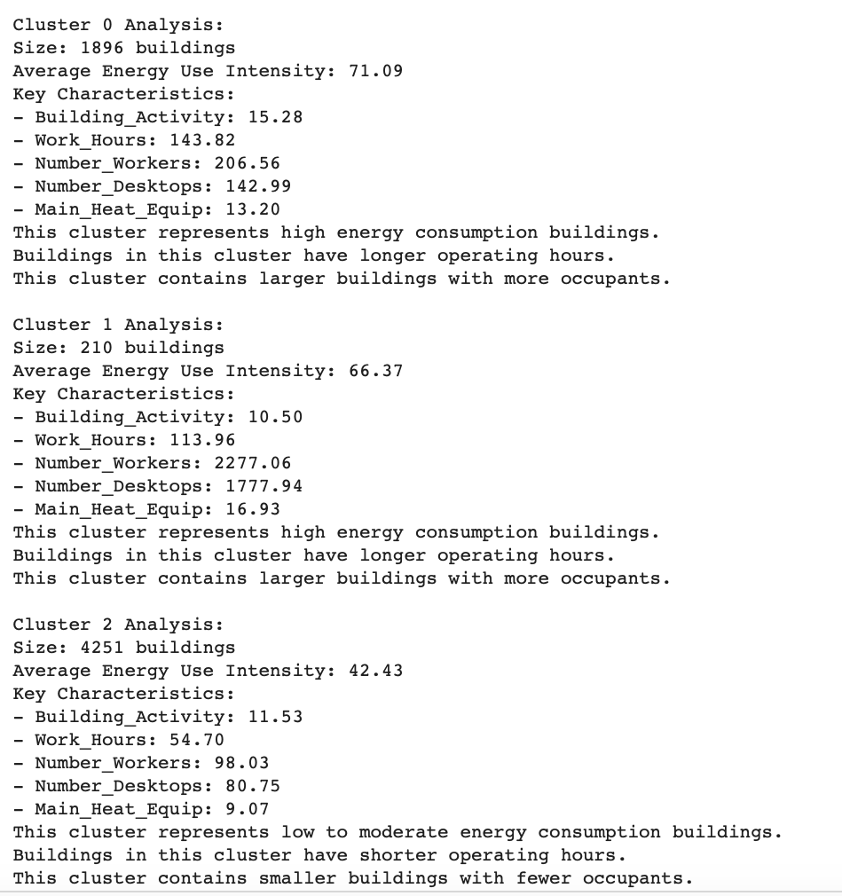
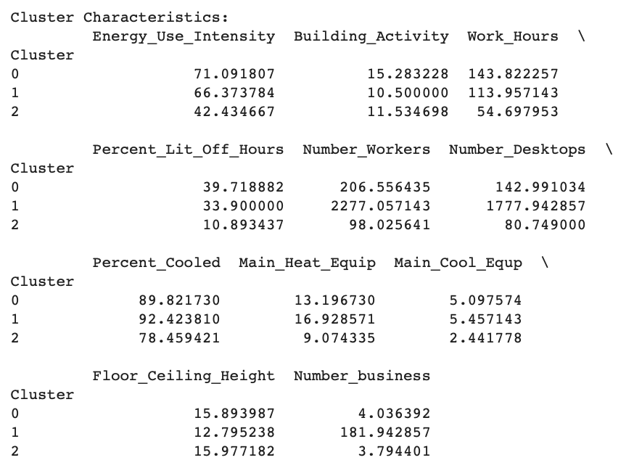
SMART Question 1

Slide 10
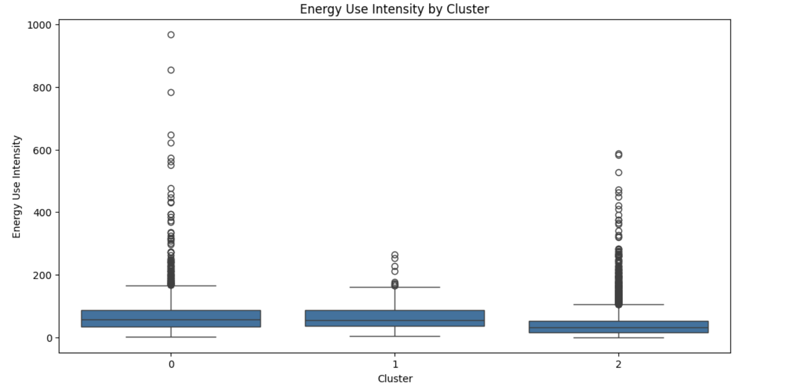
SMART Question 1

Slide 11
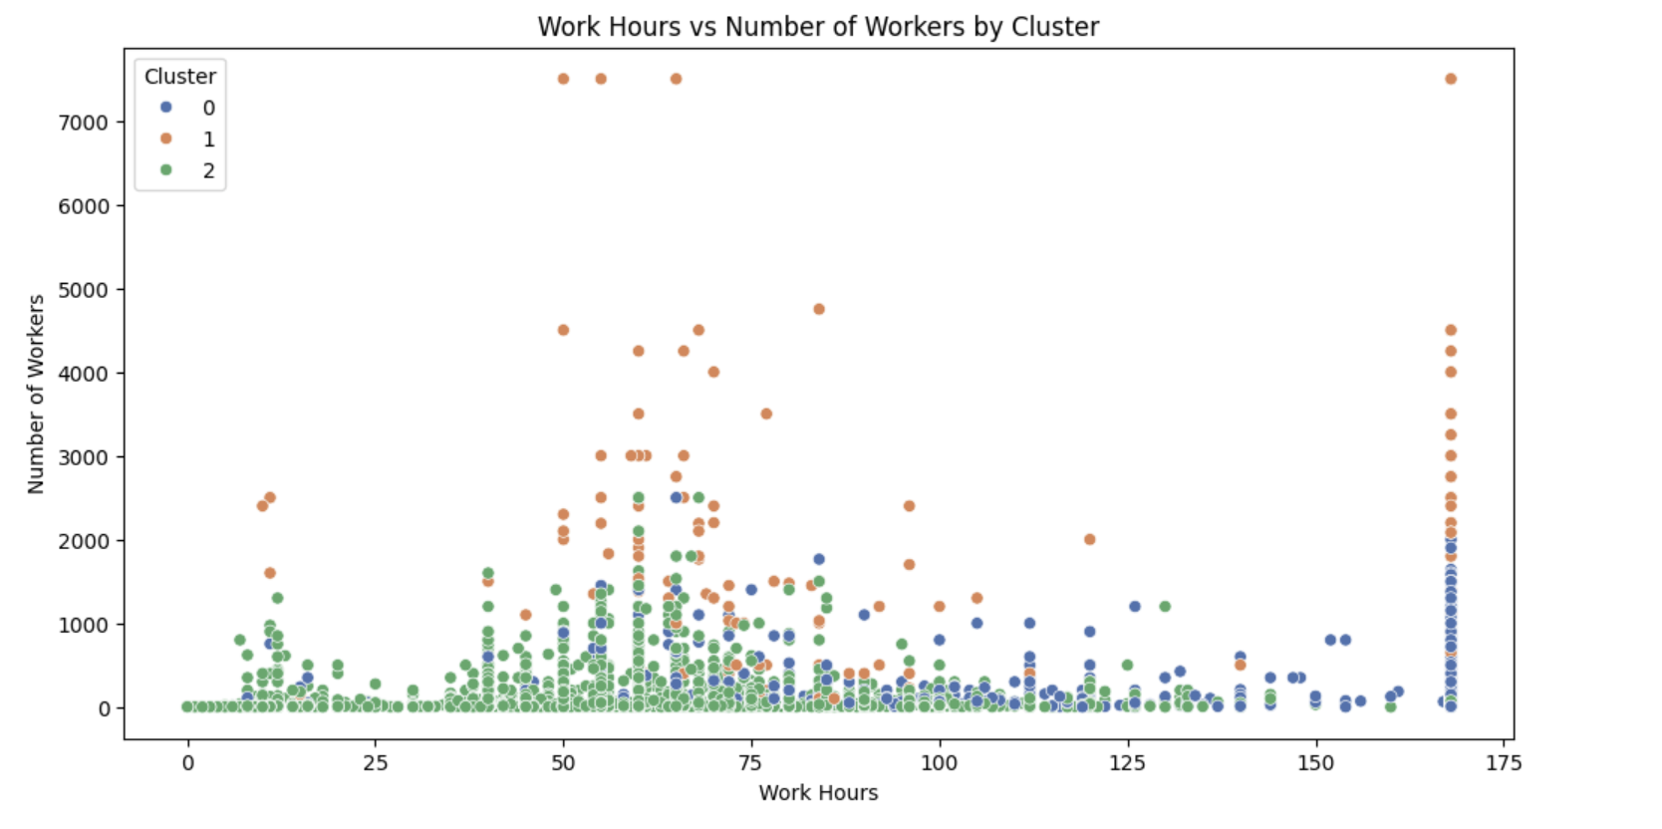
SMART Question 1

Slide 12
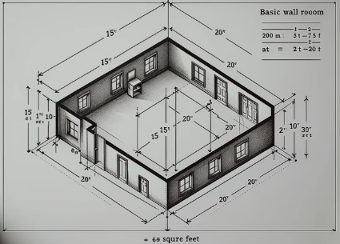
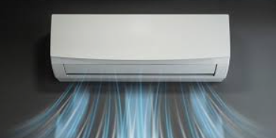
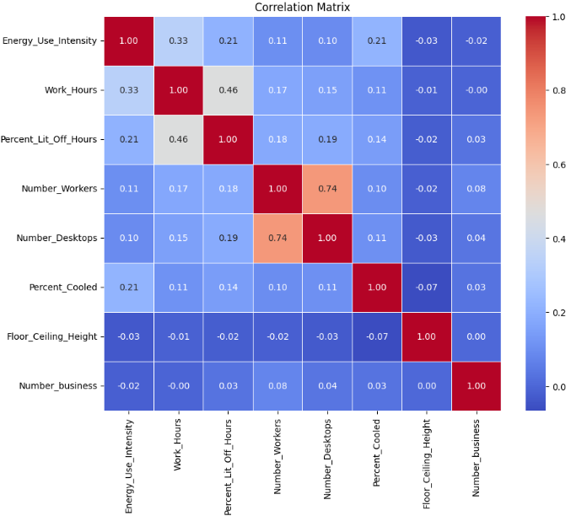

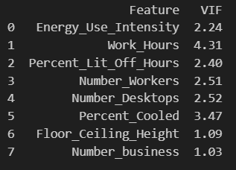
Correlation Matrix

Slide 13
SMART Q2:
How do the percentage of a building area that is cooled and the type of main cooling equipment influence Energy Use Intensity (EUI)?

Slide 14
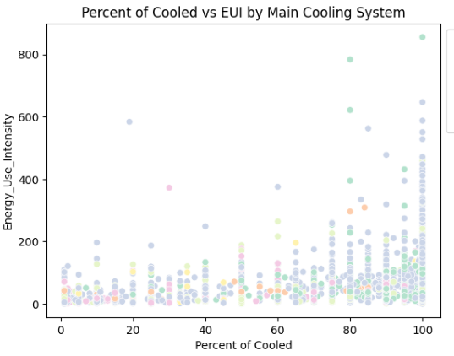
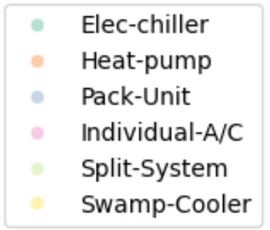
SMART Question 2
Percent of Cooled vs EUI, colored by Main Cooling System

Slide 15
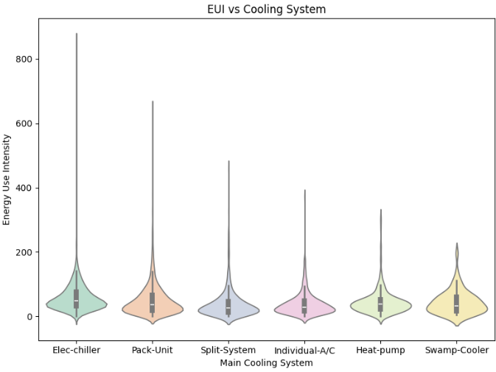
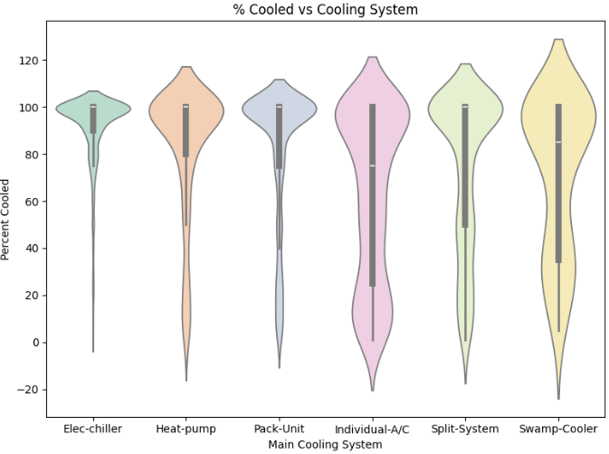
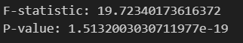
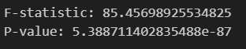
SMART Question 2

Slide 16
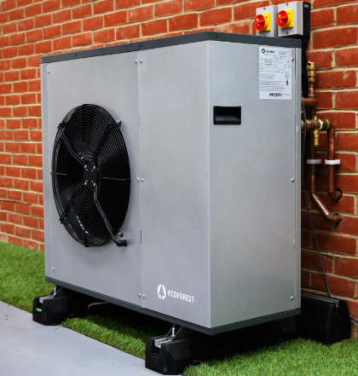
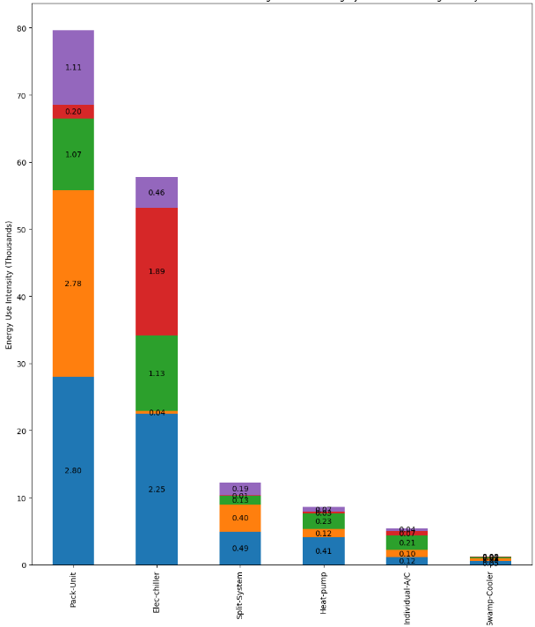
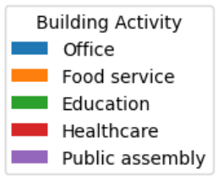
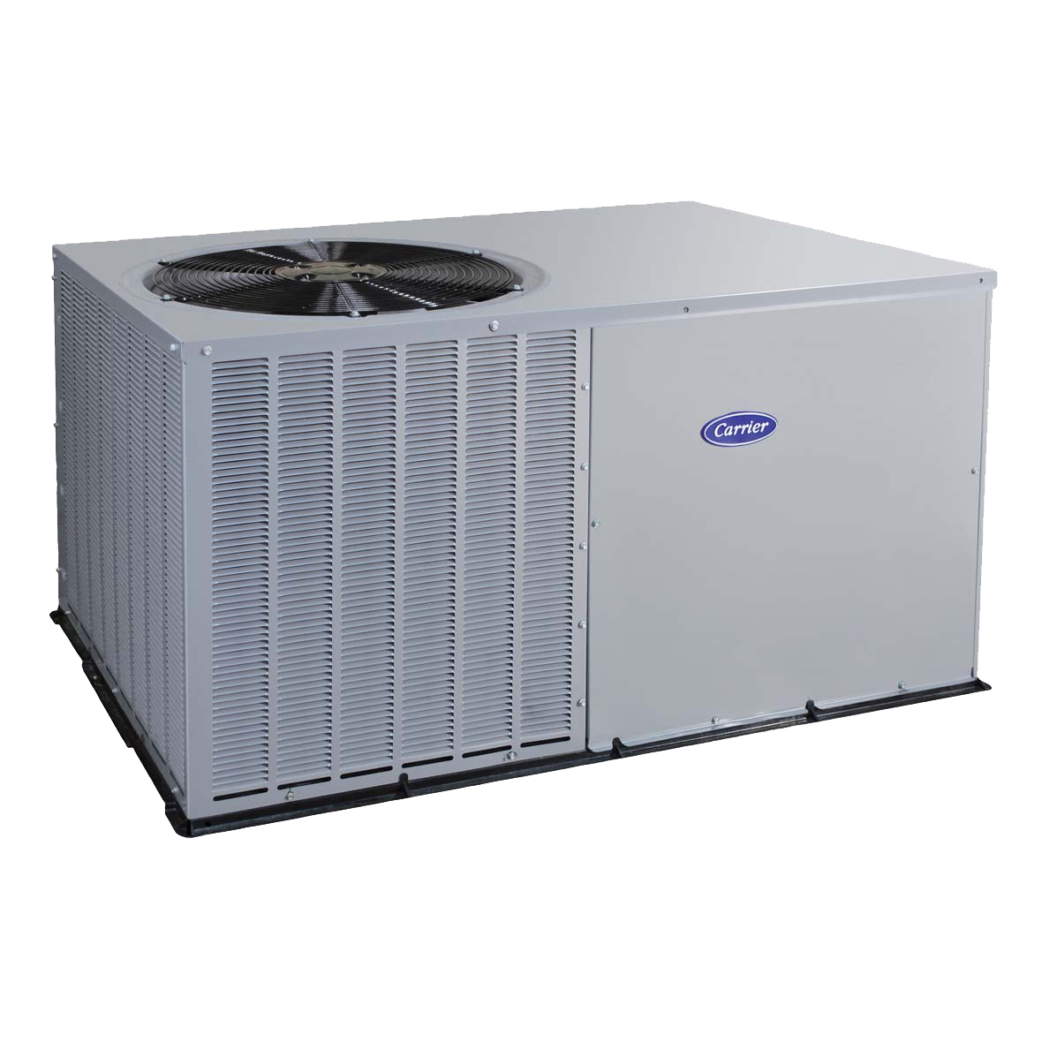
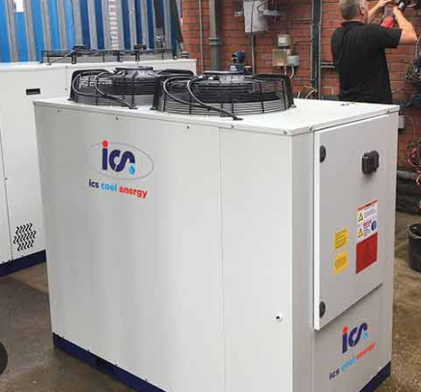
SMART Question 2
Annual EUI according to Main Cooling System by Building Activity

Slide 17
Modeling
The objective of the modeling is to identify the features that have the most influence in predicting energy consumption per square foot (Sqft²). To achieve this, we trained several models and analyzed the R², MSE, residual plots, and feature importance.

Slide 18
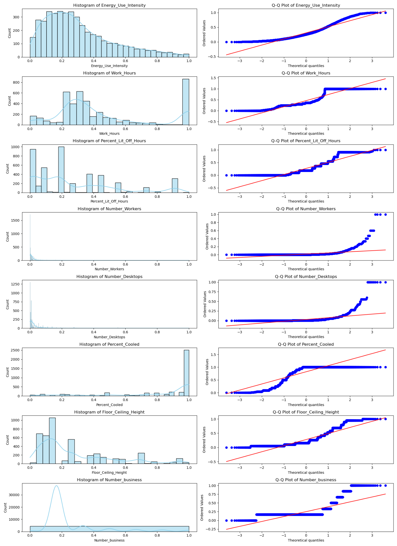
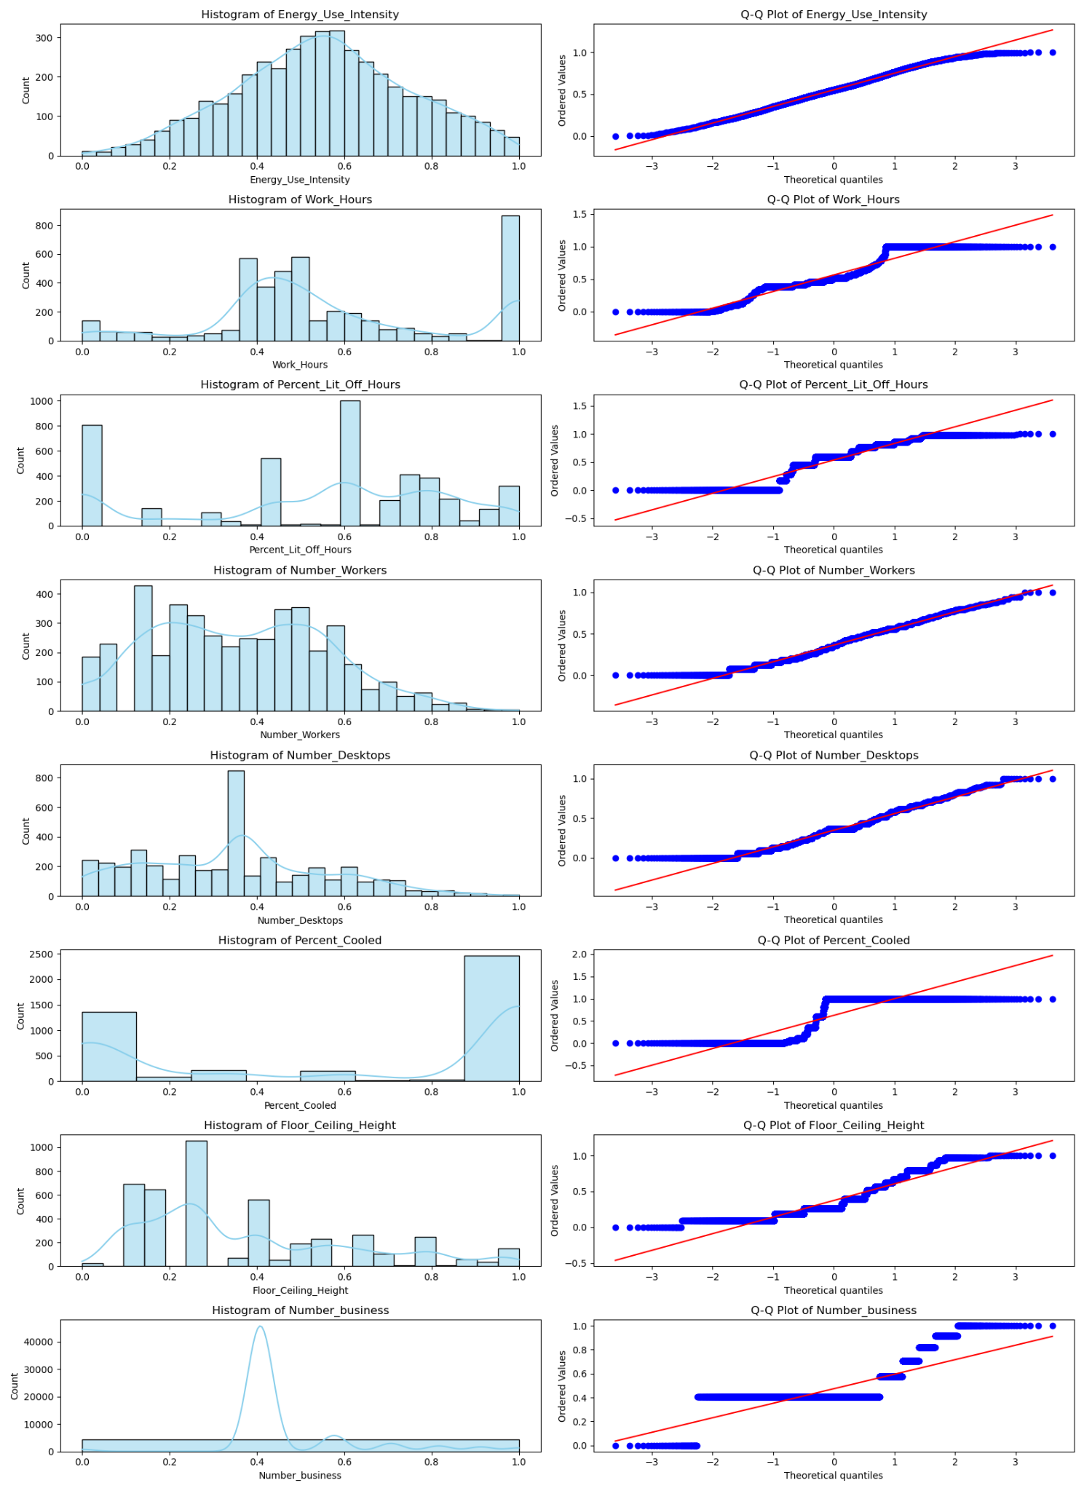
Feature Transformation
Target Variable
Log / Sqrt / Exponential /
boxcox

Slide 19
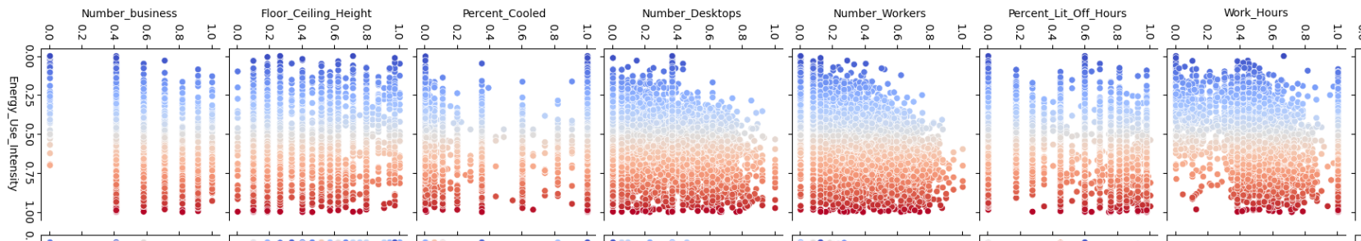
Pair Plot
Since there is no Linear Correlation between Quantitative variables and Target Variable we need to use polynomial Regression or Tree based models instead of Linear.

Slide 20
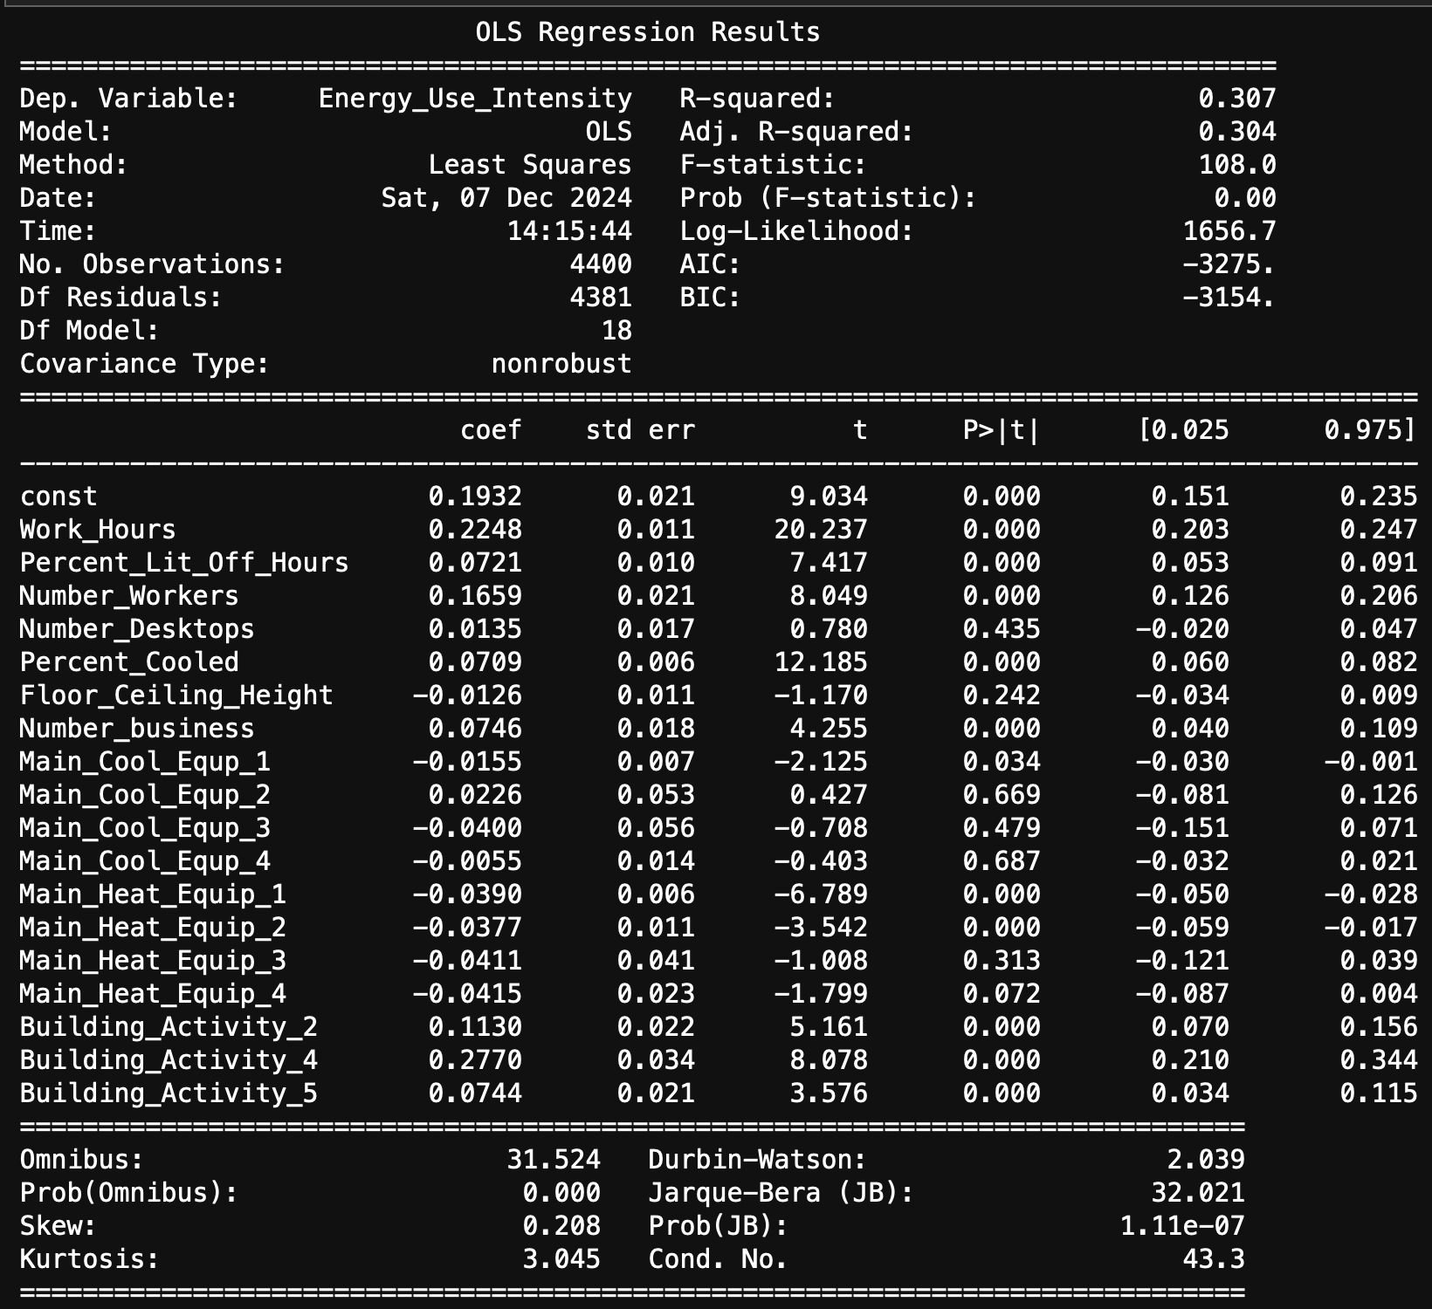
OLS
1. Work_Hours
- Coefficient: 0.2248
- This is the most significant positive contributor to Energy Use Intensity (EUI). Buildings with longer work hours consume more energy per square foot, as indicated by the high t-value (20.237) and low p-value (< 0.0001).
2. Percent_Cooled
- Coefficient: 0.0709
- The percentage of cooled areas in a building is a strong predictor of EUI. It has a significant positive effect, emphasizing the energy demands of cooling systems, as seen by the t-value (12.185) and a very low p-value (< 0.0001).
3. Number_Workers
- Coefficient: 0.1659
- The number of workers also positively influences EUI. Higher occupancy increases energy usage, likely due to lighting, equipment usage, and HVAC needs. This feature has a strong statistical significance (p-value < 0.0001).
R-Squared : 0.307

Slide 21
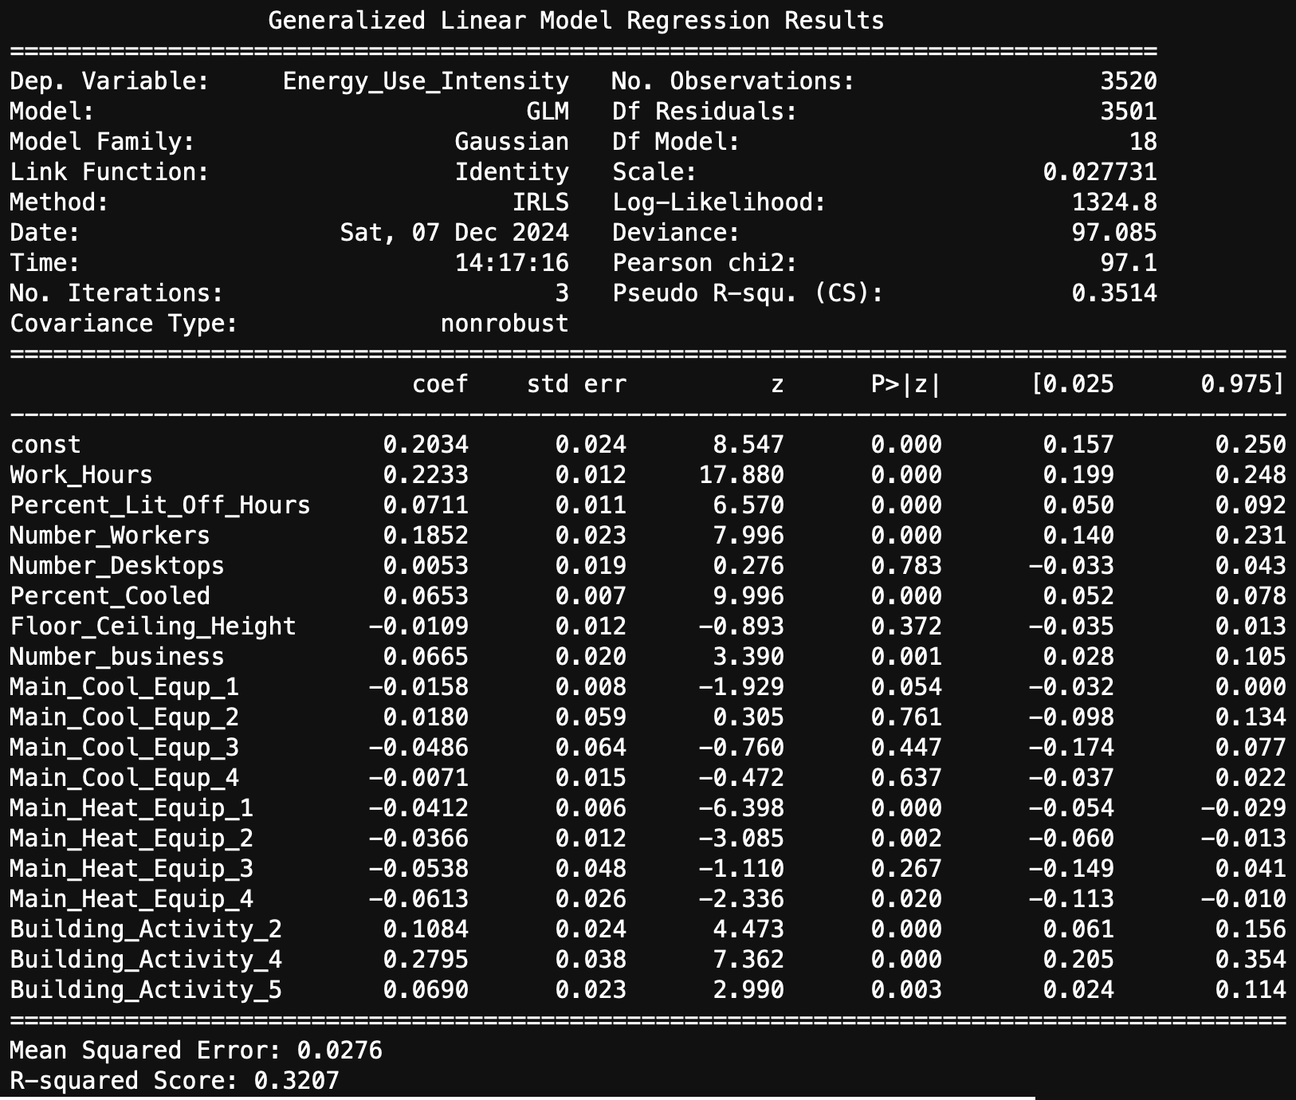
1. Work_Hours
- Coefficient: 0.2233
- Work hours have the most substantial positive effect on Energy Use Intensity (EUI), confirming that increased operational hours drive higher energy consumption. This feature's high z-value (17.880) and significant p-value (< 0.0001) highlight its importance.
2. Percent_Cooled
- Coefficient: 0.0653
- The percentage of cooled areas strongly influences energy use, emphasizing the energy demand of cooling systems. This feature demonstrates statistical significance with a high z-value (9.996) and a low p-value (< 0.0001).
3. Number_Workers
- Coefficient: 0.1852
- The number of workers is a critical determinant of EUI, with increased occupancy correlating to higher energy use due to lighting, equipment, and HVAC requirements. This feature shows strong significance with a z-value of 7.996 and a p-value (< 0.0001).
GLM
R-Squared : 0.3207

Slide 22
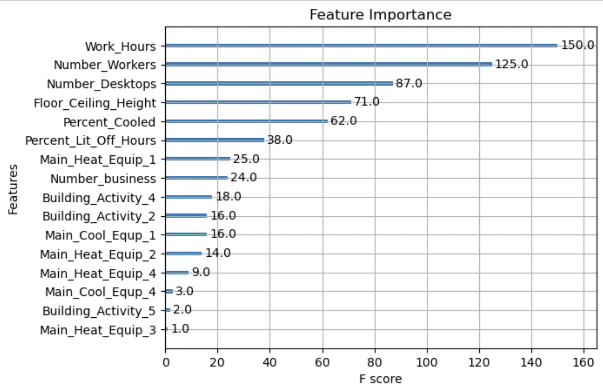
XGBoost
R-Squared : 0.3645

Slide 23
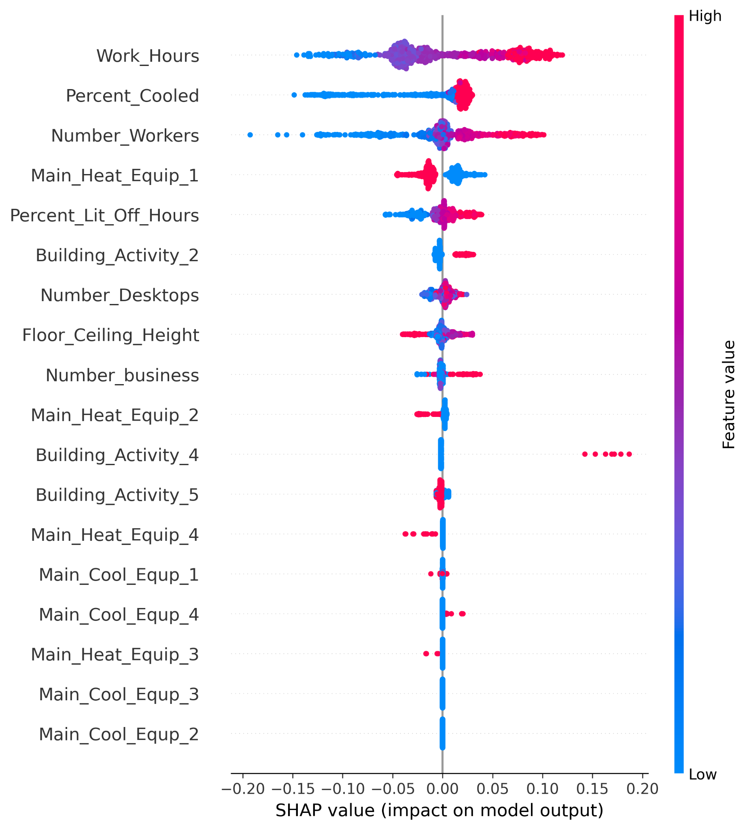
SHAP values provide a breakdown of each feature's contribution to a specific prediction, making it the most widely-used explainability tool for tree-based models like XGBoost.
1. Work_Hours: This feature has the highest mean absolute SHAP value (0.053387), indicating it is the most influential driver of predictions in the model. Changes in this variable strongly impact the predicted energy use intensity.
2. Percent_Cooled: With a SHAP value of 0.030052, it is the second most important feature, highlighting the significant role cooling coverage plays in determining energy use.
3. Number_Workers: Ranked third with a SHAP value of 0.029063, this feature emphasizes the contribution of workforce size to energy consumption patterns.
4. Main_Heat_Equip_1: This heating equipment variable (0.015071) impacts the predictions moderately, suggesting that the type or usage of primary heating equipment influences energy use.
SHAP (SHapley Additive exPlanations)

Slide 24
Modeling Conclusion
While the overall performance of our models was suboptimal due to the use of a partial dataset (10 out of 600+ variables), we identified that features such as Work_Hours, Percent_Cooled, Number_Workers, and Main_Heat_Equip_1 demonstrate significant predictive power for estimating Energy Use Intensity (EUI). However, since the dataset is based on survey results, it contains numerous outliers, which add significant noise to the overall data.
OLS | GLM | XGBoost
R2 | 0.307 | 0.3207 | 0.3645

